Slide 1
Digital Image Processing Lecture – 4-5
Course Teacher:
Md. Rayhan Ahmed
Rayhan@cse.uiu.ac.bd

Slide 2
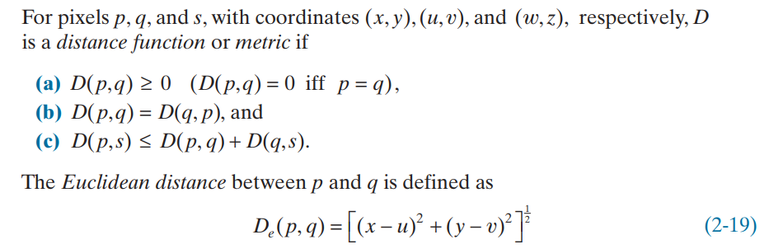
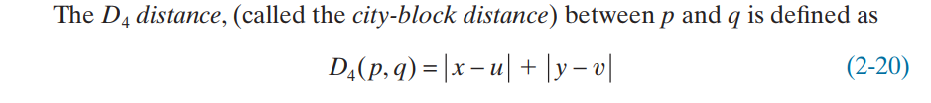
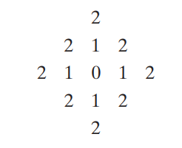
DISTANCE MEASURES BETWEEN PIXELS
For example, the pixels with D4 distance ≤ 2 from (x,y) (the center point) form the following contours of constant distance:

Slide 3
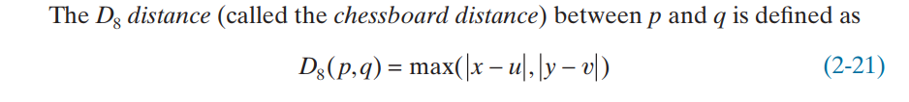
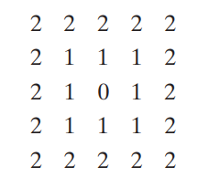
DISTANCE MEASURES BETWEEN PIXELS
For example, the pixels with D8 distance ≤ 2 form the following contours of constant distance:

Slide 4
DISTANCE MEASURES BETWEEN PIXELS
Note that the D4 and D8 distances between p and q are independent of any paths that might exist between these points because these distances involve only the coordinates of the points.
In the case of m-adjacency, however, the Dm distance between two points is defined as the shortest m-path between the points. In this case, the distance between two pixels will depend on the values of the pixels along the path, as well as the values of their neighbors.
Question: An image segment is shown below: Let V be the set of gray level values used to define connectivity in the image. Compute D4, D8, and Dm distances between pixels p and q for:
V={2,3}
V={2,6}
Here, p (x,y)=(0,0)and q (s,t)=(4,4)
Solution: D4 = 8, D8= 4
Solution: Dm, V={2,3} = no path, q(6) is not included in V
Solution: Dm, V={2,6} = no path between p and q.
2(p) | 3 | 2 | 6 | 1
6 | 2 | 3 | 6 | 2
5 | 3 | 2 | 3 | 5
2 | 4 | 3 | 5 | 2
4 | 5 | 2 | 3 | 6(q)

Slide 5
DISTANCE MEASURES BETWEEN PIXELS
Another Question: An image segment is shown below: Let V be the set of gray level values used to define connectivity in the image. Compute D4, D8, and Dm distances between pixels p and q for:
V={0,1}
V={1,2}
Here, p (x,y)=(0,0)and q (s,t)=(3,3)
Solution: D4 = 6, D8= 3
Solution: Dm, V={0,1} = 5
Solution: Dm, V={1,2} = 6
3 | 1 | 2 | 1(q)
0 | 2 | 0 | 2
1 | 2 | 1 | 1
1(p) | 0 | 1 | 2

Slide 6
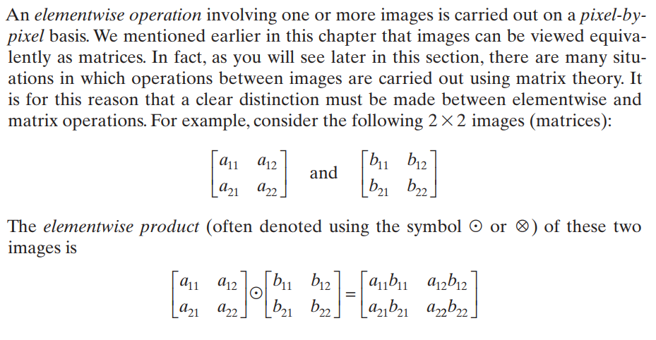
ELEMENTWISE VERSUS MATRIX OPERATIONS

Slide 7
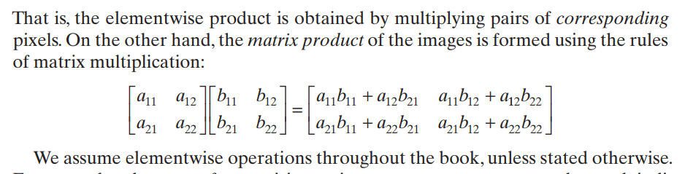
ELEMENTWISE VERSUS MATRIX OPERATIONS

Slide 8
Basic Image Intensity Transformations Point Operations
Digital Negative
Thresholding
Clipping
Bit-Plane Slicing
Contrast Stretching
Material: Hand Notes + Book

Slide 9
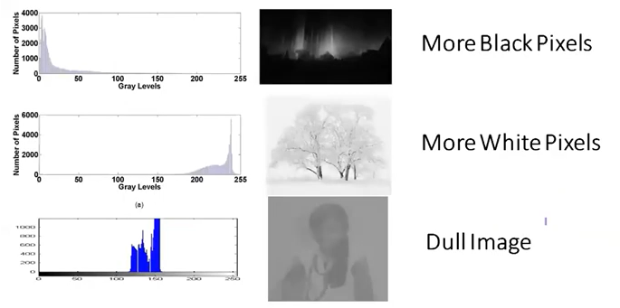
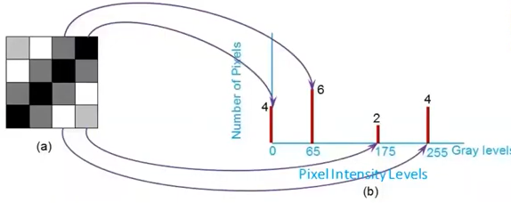
Basic Image Intensity Transformations Histogram Equalization
The histogram of an image is a function that maps each gray level of an image to the number of times it occurs in the image.

Slide 10
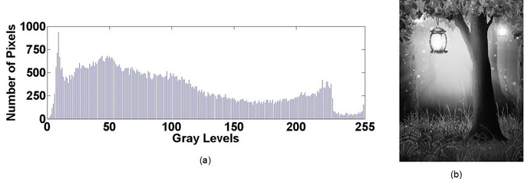
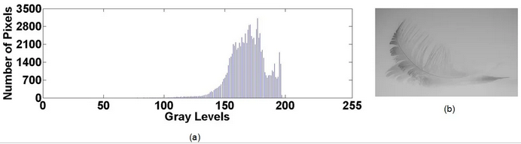
Basic Image Intensity Transformations Histogram Equalization
Histogram of a high-contrast image
Histogram of a low-contrast image

Slide 11
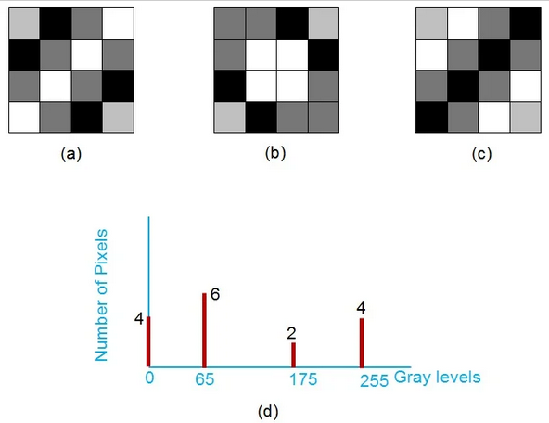
Basic Image Intensity Transformations Histogram Equalization
Drawback
One limitation that we need to keep in mind is that a histogram provides no information regarding the spatial distribution of an image’s pixel values. Thus, we can have multiple different images that share the same histogram and we cannot reconstruct an image from its histogram.
Different images that have the same histogram

Slide 12
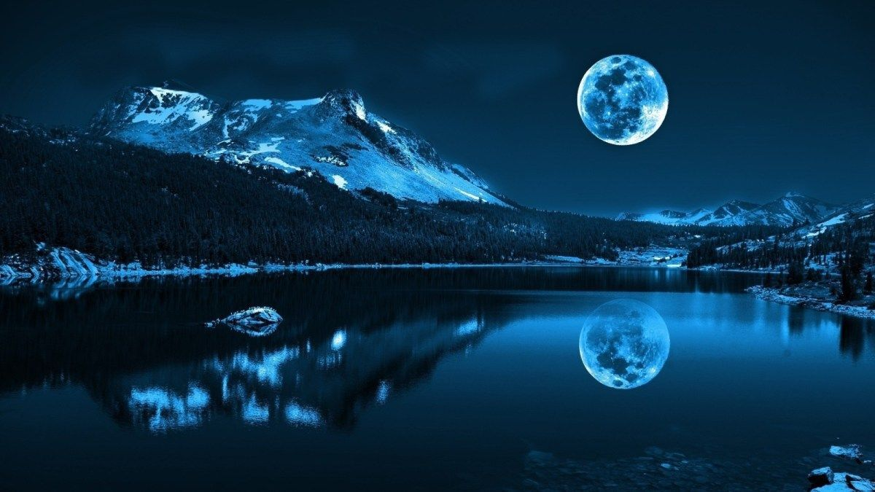
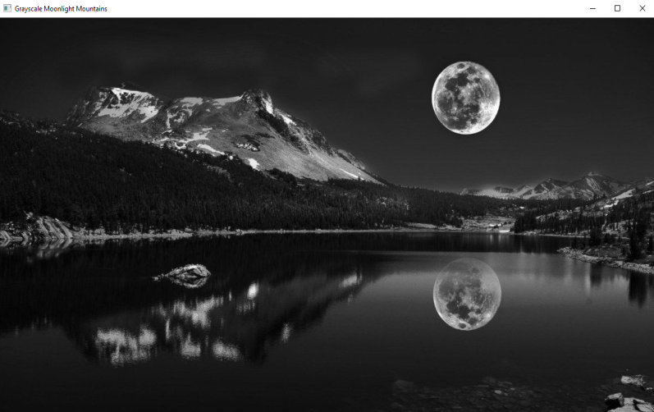
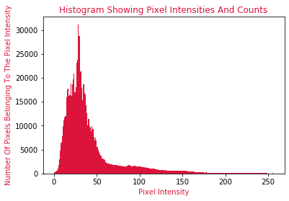


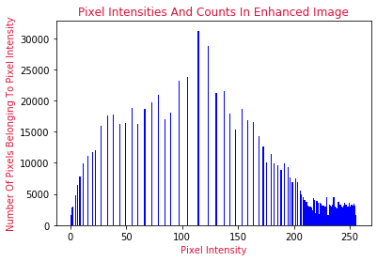
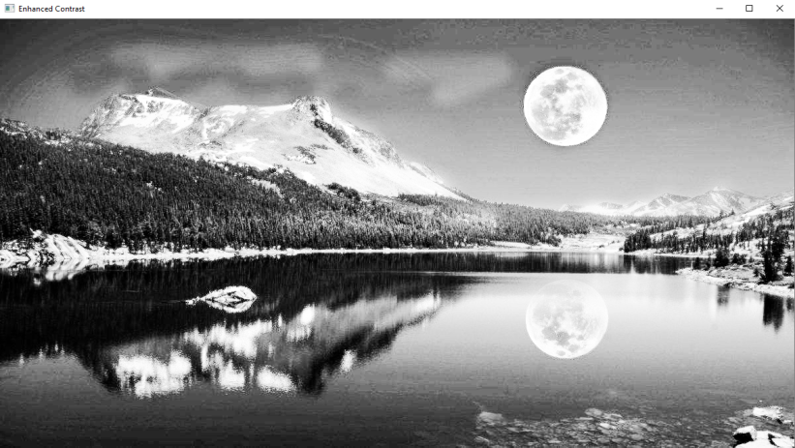

Applications of Histogram

Slide 13
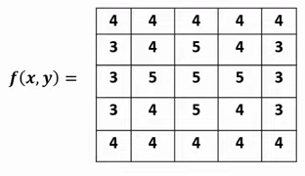
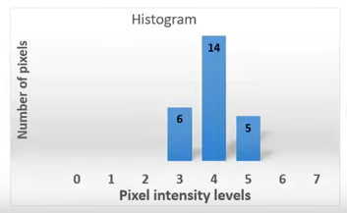
Basic Image Intensity Transformations Histogram Equalization
Ex: Perform Histogram Equalization on the following image.
Solution:
Here, maximum gray value=5
Number of bits required to represent each intensity = 3 bits
Number of possible gray level values = 0 to 7
Gray level | 0 | 1 | 2 | 3 | 4 | 5 | 6 | 7
No. of Pixel (nk) | 0 | 0 | 0 | 6 | 14 | 5 | 0 | 0

Slide 14
Basic Image Intensity Transformations Histogram Equalization
Gray level | No. of Pixel nk | Probability Distribution Function (PDF) nk/N | Cumulative Distribution Function (CDF) Sk | Running Sum x Maximum gray level Sk x 7 | Round off Histogram equalization level
0 | 0 | 0/25 = 0 | 0 | 7x0=0 | 0
1 | 0 | 0/25 = 0 | 0 | 7x0=0 | 0
2 | 0 | 0/25 = 0 | 0 | 7x0=0 | 0
3 | 6 | 6/25 = 0.24 | 0.24 | 7x0.24=1.68 | 2
4 | 14 | 14/25 = 0.56 | 0.80 | 7x0.8=5.6 | 6
5 | 5 | 5/25 = 0 | 1 | 7x1=1 | 7
6 | 0 | 0/25 = 0 | 1 | 7x1=1 | 7
7 | 0 N=25 | 0/25 = 0 | 1 | 7x1=1 | 7

Slide 15
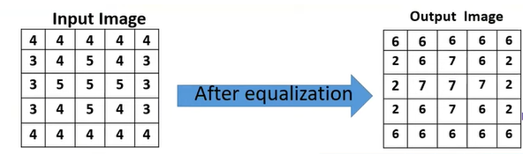

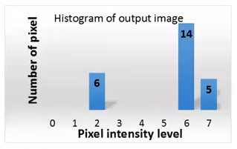
Basic Image Intensity Transformations Histogram Equalization

Slide 16
Basic Image Intensity Transformations Histogram Matching
Ex: Given Histogram (a) & (b), modify (a) as given by (b).
(a)
(b)
Gray Level | 0 | 1 | 2 | 3 | 4 | 5 | 6 | 7
No. of Pixels | 80 | 100 | 90 | 60 | 30 | 20 | 10 | 0
Gray Level | 0 | 1 | 2 | 3 | 4 | 5 | 6 | 7
No. of Pixels | 0 | 0 | 0 | 60 | 80 | 100 | 80 | 70

Slide 17
Basic Image Intensity Transformations Histogram Matching

Slide 18
Basic Image Intensity Transformations Histogram Matching- HE(a)
Gray level | No. of Pixel nk | Probability Distribution Function (PDF) nk/N | Cumulative Distribution Function (CDF) Sk | Running Sum x Maximum gray level Sk x 7 | Round off Histogram equalization level | New nk
0 | 80 | 80/390 = 0.20 | 0.20 | 7x0.20=1.4 | 1 | 80
1 | 100 | 100/390 = 0.25 | 0.45 | 7x0.45=3.15 | 3 | 100
2 | 90 | 90/390 = 0.23 | 0.68 | 7x0.68=4.76 | 5 | 90
3 | 60 | 60/390 = 0.15 | 0.83 | 7x0.83=5.81 | 6 | 90
4 | 30 | 30/390 = 0.07 | 0.90 | 7x0.90=6.3 | 6
5 | 20 | 20/390 = 0.05 | 0.95 | 7x0.95=6.65 | 7 | 30
6 | 10 | 10/390 = 0.02 | 0.97 | 7x0.97=6.79 | 7
7 | 0 N=390 | 0/390 = 0 | 0.97 | 7x0.97=6.79 | 7

Slide 19
Basic Image Intensity Transformations Histogram Matching – HE(b)
Gray level | No. of Pixel nk | Probability Distribution Function (PDF) nk/N | Cumulative Distribution Function (CDF) Sk | Running Sum x Maximum gray level Sk x 7 | Round off Histogram equalization level
0 | 0 | 0 | 0 | 0 | 0
1 | 0 | 0 | 0 | 0 | 0
2 | 0 | 0 | 0 | 0 | 0
3 | 60 | 0.15 | 0.15 | 1.05 | 1
4 | 80 | 0.20 | 0.35 | 2.45 | 2
5 | 100 | 0.25 | 0.6 | 4.2 | 4
6 | 80 | 0.20 | 0.8 | 5.6 | 6
7 | 70 N=390 | 0.17 | 0.87 | 6.79 | 7

Slide 20
Basic Image Intensity Transformations Histogram Matching – Matching
Take the first and last columns on histogram (b), and Take the last two columns of histogram (a).
histogram (b) histogram (a)
Gray Level | HE Level
0 | 0
1 | 0
2 | 0
3 | 1
4 | 2
5 | 4
6 | 6
7 | 7
Gray Level | HE Level
1 | 80
3 | 100
5 | 90
6 | 90
6
7 | 30
7
7

Slide 21
Basic Image Intensity Transformations Histogram Matching – Matching
Gray Level | 0 | 1 | 2 | 3 | 4 | 5 | 6 | 7
No. of Pixels | 0 | 0 | 0 | 80 | 80 | 100 | 90 | 30

Slide 22
HE - Demo
import cv2
import matplotlib.pyplot as plt
img = cv2.imread('/image_1.jpg',0)
hist1 = cv2.calcHist([img],[0],None,[256],[0,256])
plt.subplot(221),plt.imshow(img);
plt.subplot(222),plt.plot(hist1);
import cv2
import matplotlib.pyplot as plt
img = cv2.imread('/image_1.jpg',0)
hist1 = cv2.calcHist([img],[0],None,[256],[0,256])
img_2 = cv2.equalizeHist(img)
hist2 = cv2.calcHist([img_2],[0],None,[256],[0,256])
plt.subplot(221),plt.imshow(img);
plt.subplot(222),plt.plot(hist1);
plt.subplot(223),plt.imshow(img_2);
plt.subplot(224),plt.plot(hist2);

Slide 23
Logarithmic Transformations
The general form of the log transformation is
s = c * log(1 + r)
Here, 's' is the output image, 'r' is the input image, and ‘c’ is a constant.
c = 255/(log(1+Max_input_pixel_value))
Scaling operation is required to represent the logarithmically transformed intensity values in a bigger range. The scaling constant ‘c’ does this.
The log transformation maps a narrow range of low input grey level values into a wider range of output values.
When logarithmic transformation is applied onto a digital image, the darker intensity values are given brighter values thus making the details present in darker or gray areas of the image more visible to human eyes.
The logarithmic transformation also scales down the brighter intensity values to lower values.
The inverse log transformation performs the opposite transformation.

Slide 24
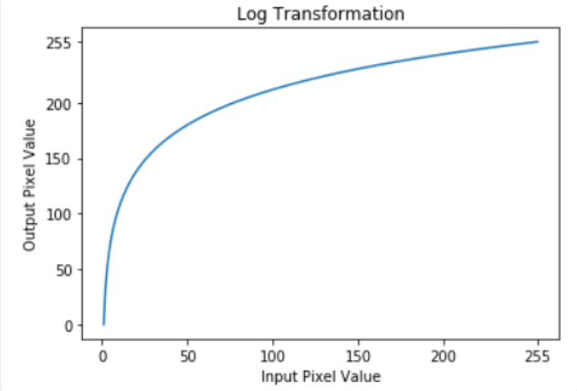
Logarithmic Transformations

Slide 25
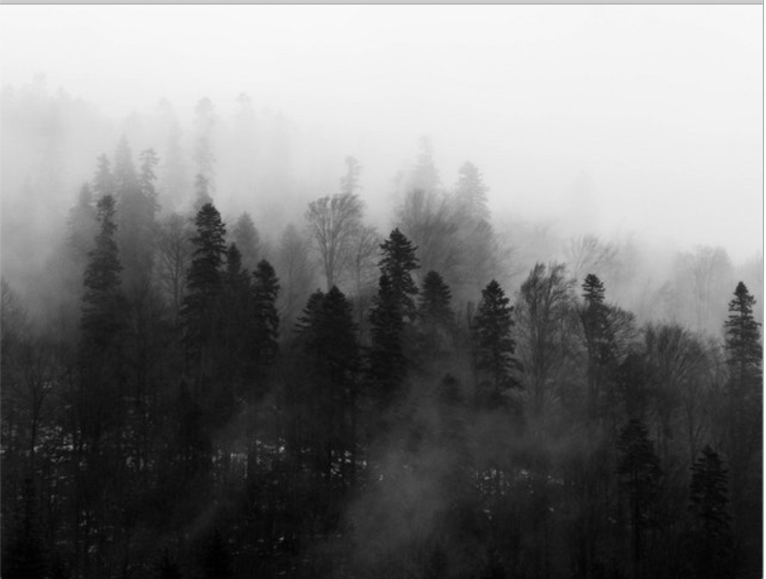
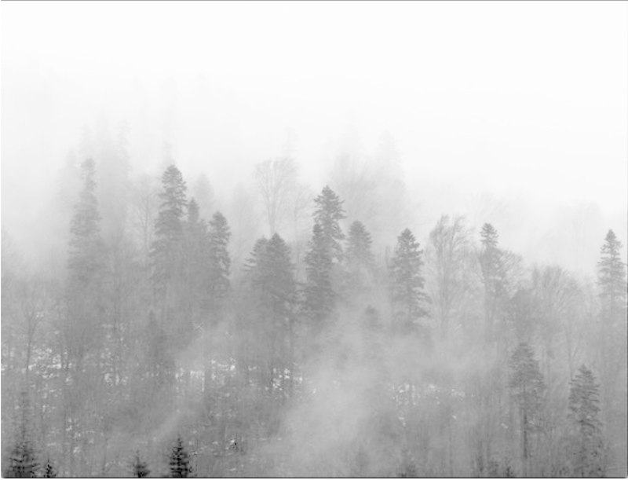
Logarithmic Transformations
Log functions are particularly useful when the input grey level values may have an extremely large range of values.
In the following example the Fourier transform of an image is put through a log transform to reveal more detail
s = c*log(1 + r)

Slide 26
Logarithmic Transformations - Code
import cv2
import numpy as np
# Open the image.
img = cv2.imread('sample.jpg')
# Apply log transform.
c = 255/(np.log(1 + np.max(img)))
log_transformed = c * np.log(1 + img)
# Specify the data type.
log_transformed = np.array(log_transformed, dtype = np.uint8)
# Save the output.
cv2.imwrite('log_transformed.jpg', log_transformed)

Slide 27
Power-Law (Gamma) Transformation
Power-law (gamma) transformations can be mathematically expressed as s = cr^{\gamma}. Gamma correction is important for displaying images on a screen correctly, to prevent bleaching or darkening of images when viewed from different types of monitors with different display settings. This is done because our eyes perceive images in a gamma-shaped curve, whereas cameras capture images in a linear fashion.
Gamma correction is a non-linear adjustment to individual pixel values. While in image normalization we carried out linear operations on individual pixels, such as scalar multiplication and addition/subtraction, gamma correction carries out a non-linear operation on the source image pixels, and can cause saturation of the image being altered.

Slide 28





Power-Law (Gamma) Transformation
Gamma = 0.1
Gamma = 0.5
Gamma = 1.2
Gamma = 2.2

Slide 29
Power-Law (Gamma) Transformation – Code
import cv2
import numpy as np
# Open the image.
img = cv2.imread('sample.jpg')
# Trying 4 gamma values.
for gamma in [0.1, 0.5, 1.2, 2.2]:
# Apply gamma correction.
gamma_corrected = np.array(255*(img / 255) ** gamma, dtype = 'uint8')
# Save edited images.
cv2.imwrite('gamma_transformed'+str(gamma)+'.jpg', gamma_corrected)

